Slide 1
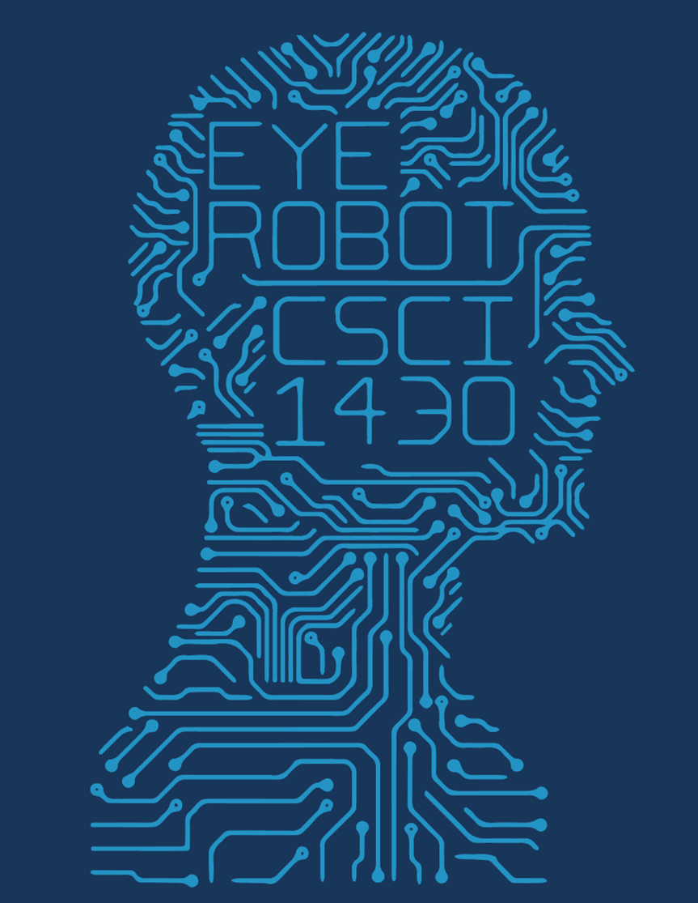
CV Final Project
Dash, but in CV
Stanley Yip and Tyler Schicke

Slide 2
The Problem…
You, a Brown student, are studying abroad
Being the Brown student that you are, you didn’t prepare to study abroad…
Uh oh…
If only you had an app that could help you out…

Slide 3
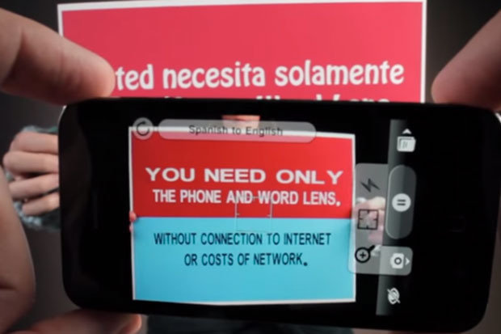
Presenting: Google Translate Word Lens!

Slide 4
The Problem…
You, a Brown student, are studying abroad
Being the Brown student that you are, you didn’t prepare to study abroad…
Uh oh…
If only you had an app that could help you out…
But you’re a Brown student, why support a tech giant like Google when you could support local businesses?

Slide 5
Our Tools
To revolutionize the phone camera app industry, we’ve harnessed the power of Machine Learning and AI to bring to you the most powerful tool to have ever hit the market…
Presenting: Word Guider!

Slide 6
The Code
import ocr
import webcam
from google import translate
from cs1430 import final_project
while True:
final_project.run(translate(ocr(webcam.image)))

Slide 7

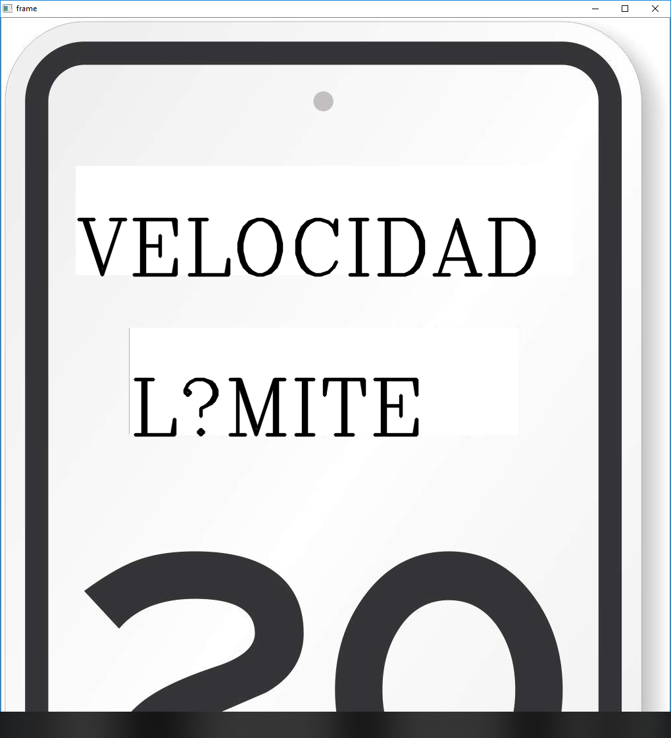
A Good Example
Before
After

Slide 8
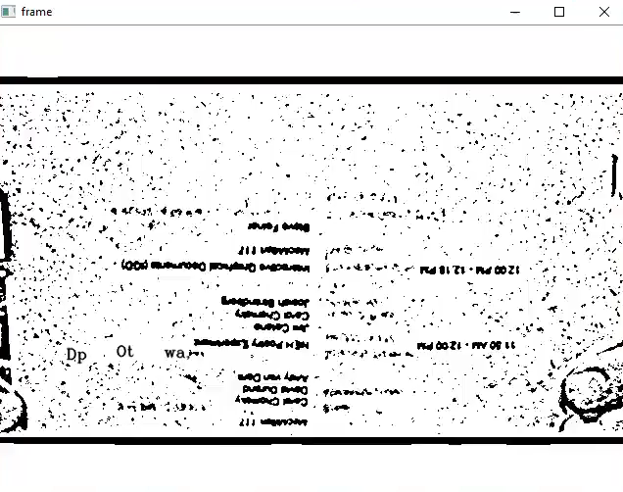
A More Common Example…

Slide 9
In Conclusion
Word Lens
Word Guider
Owned by a giant tech company
Doesn’t show you cool filters
Lame name
Boring, expected results
Not owned by any company
Shows you how the camera sees you
Cool name!
Unique and quirky results

